Slide 1

GALGOTIAS UNIVERSITY
SCHOOL OF COMPUTING SCIENCE AND ENGINEERING
Project ID: BT2177
Title: A REVIEW ON QUANTUM CRYPTOGRAPHY USING ENCRYPTION AND DECRYPTION
PROJECT MEMBERS
KARANJEET SINGH 21SCSE101644
ABHINAV KUMAR CHOUDHARY 21SCSE1011615
SHIVANI KUMARI 21SCSE1011614
EBAD ZAFAR 21SCSE1011484
Under the guidance
Mr. Janarthanan.S
Assistant Professor

Slide 2
CONTENT:
INTRODUCTION
HISTORY
PRINCIPLES
MODERN CRYPTOGRAPHY
CLASSIC VS QUANTUM BITS
QUBIT REPRESENTATION
QKD
STEPS IN QKD
SECURE COMMUNICATION USING QKD
VULNERABLITIES IN QKD
MERITS
DEMERITS
REFERENCES

Slide 3
Introduction
Quantum cryptography is a method of encryption that uses the properties of quantum mechanics to secure and transmit data so that it cannot be hacked or tracked by anyone who shouldn’t have its access .
it is highly secured model which is based on transfer of photon which is called qubit .
QKD, also called Quantum Cryptography, is a mechanism to develop secure communication . QKD is essential to address the threat that rapid advancement in Quantum Computing poses to the security of the data being transported by various critical sectors through the current communication networks.

Slide 4
History
Charles H. Bennett and Gilles Brassard revived the field in 1982 by combining quantum process with public key cryptography.
First proposed by Stephen Wiesner, then at Columbia University in New York, who, in 1968 or later, introduced the concept of quantum money and quantum conjugate coding.

Slide 5
Principle :
Quantum cryptography adapts quantum mechanical principles like Heisenberg Uncertainty principle and photon polarization principle .
It works on the principle of polarisation of data in the form of waves .

Slide 6
Quantum bits :Fundamental unit of Quantum Information
Mathematically, a qubit is a vector representing probabilities of 0 and 1 with the help of
magnitude coefficient α and β respectively which are restricted to constitute a probability of 1
i.e. α^2+ β^2=1. If α reaches to 1 then β will tend to 0.
The following equation gives an idea how a qubit works mathematically:
Qubit Q = |α|0 + |β|1
The values of coefficients depend on the complex numbers which are real numbers that makes coefficients real as well. If either α or β reaches to 1, other must be 0 . Let us imagine explain the difference between classical computers (N^2) and Quantum computers (2^n). In a puzzle, a classical computer will start the solution from start if it hits a dead end or a wall whereas in a Quantum computer, properties of qubit helps in continuing the calculation for the solution.
The Literature review on Quantum Leap explains the idea of quantum computing and what
difficulties it takes to achieve. Later the literature discusses the research in progress behind
quantum computing and its prowess.

Slide 7
Classic bits vs quantum bits:
There are two possible outcomes for the measurement of a qubit—usually taken to have the value "0" and "1", like a bit or binary digit. However, whereas the state of a bit can only be either 0 or 1, the general state of a qubit according to quantum mechanics can be a coherent superposition of both.
Moreover, whereas a measurement of a classical bit would not disturb its state, a measurement of a qubit would destroy its coherence and irrevocably disturb the superposition state. It is possible to fully encode one bit in one qubit. However, a qubit can hold more information, e.g., up to two bits using superdense coding.
For a system of n components, a complete description of its state in classical physics requires only n bits, whereas in quantum physics it requires 2^{n} complex numbers (or a single point in a 2^{n}-dimensional vector space)

Slide 8
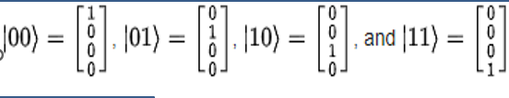
Representation of two qubits:
These two orthonormal basis states, {|0> ,|1>}, together called the computational basis, are said to span the two-dimensional space of the qubit.
Qubit basis states can also be combined to form product basis states. A set of qubits taken together is called a quantum register. For example, two qubits could be represented in a four-dimensional linear vector space spanned by the following product basis states:

Slide 9
Quantum key distribution
The concept of quantum key distribution (QKD) was first proposed in the 1970s but it wasn’t until the 1980s that it really came to light.
QKD is a means of distributing keys from one party to another, and detecting eavesdropping
It uses the fact that quantum mechanics does not allow for distinguishing non-orthogonal states with certainty.
QKD requires only an insecure quantum channel and authenticated (but unencrypted) classical channels, but unfortunately requires multiple rounds of back- and-forth communication between Alice and Bob.

Slide 10
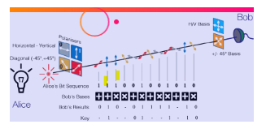
Steps in QKD
Typically, information is encoded on single photons, as shown in the figure. Alice can chose to encode these in a “bit sequence” using one of two states, like vertical (V) or horizontal (H) Polarization , and she also can chose to encode in two different states; here, two combinations of these states labeled +45° and -45°.
Bob then choses to measure in one of the two, what we call bases – either he measures H,V, or he measures +45°, -45°.
If Bob choses the right polarization same as alice then that photon included in the final
extract of private key otherwise discarded.

Slide 11
Secure communication Using QKD
Quantum key distribution is closely related to a slightly stronger protocol called unclonable encryption, which uses quantum states to send an encrypted classical message which cannot be read or even copied by Eve.
The synchronized photons are used to form the basis of a onetime pad for sending encrypted information. It is important to point out that neither Alice nor Bob are able to determine what the key will be in advance because the key is the product of both their random choices.
Thus, quantum cryptography enables the distribution of a one-time key exchanged securely.

Slide 12
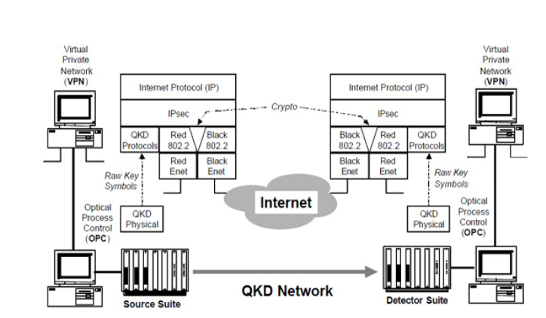
Secure internetwork connection

Slide 13
Vulnerablities in QKD
Instead of producing a single photon, a laser may produce two; Eve can keep one and give the other to Bob. She can then learn what polarization Alice sent without revealing her presence.
Ultimately, we cannot have confidence that a real-life quantum cryptographic system is secure until it has withstood attacks from determined real-life adversaries.
protocols are shown to be vulnerable to a classic man-in-the-middle attack using entangled pairs created by Eve. Because it relies on manipulation and return of entangled qubits to create a shared key.

Slide 14
Merit :
Provides secure communication
Detects Spy
Offers multiple methods for security
Data Integrity
Authentication

Slide 15
Demerit :
Maintaining A Quantum Communication Network
Transferring Quantum States
Public Trust
Sharing Infrastructure
Changes in polarization and error rates

Slide 16
Applications :
Quantum-encrypted video call(trial early this year).
Secure voting(Switzerland since 2007).
Quantum Smart Card(Los Alamos National Lab).
Secure the network of higher official.

Slide 17
REFERENCE:
Minor thesis quantum heap nov 2020:by Manish Y
Research paper on quantum cryptography from
googlescholar.com
Brassard, G. Cryptology column — 25 years of quantum cryptography. Sigact News 27(3) (1996), 13–24.
Gottesman, D., and Lo, H.-K. From quantum cheating to quantum security. Physics Today 53, 11 (Nov. 2000), 22.
Lo, H.-K. Quantum Cryptology. World Scientific, 1998.
Singh, S., 1999, The Code Book: The Science of Secrecy from Ancient Egypt to Quantum Cryptography (Fourth Estate, London).
Stanford university research paper: J. Aditya, P. Shankar Rao {Dept of CSE, Andhra University}Conference paper 2020 november: by azeem iqbalSahar nayab

Slide 18
THANK YOU

